Slide 1


DR. D. Y. PATIL INSTITUTE OF TECHNOLOGY
(formerly Dr. D. Y. Patil Institute of Engineering and Technology)
Sant Tukaram Nagar, Pimpri, Pune.
DATA
Presented by
Guided by
SAI&D02 Prathamesh Patil
Prof. Shubhangi Vairagar Ma’am
SAI&D07 Ganesh Jagzap
SAI&D08 Jay Sawant
SAI&D09 Atharv Wankhede

Slide 2
Shortlisted Topics
Disease Prediction
Movies Recommendation
1
4
Credit card
fraud detection
Sales Recommendation
2
3

Slide 3
Disease Prediction Using Machine Learning
Presented by -
Prathamesh Patil

Slide 4
Abstract
Disease prediction using machine learning is a system where diseases are predicted by the machine learning algorithm on the basis of the symptoms provided by the user.
Machine learning can play a major role in the future of healthcare by helping to predict various harmful diseases based on certain symptoms.

Slide 5
Introduction
Machine learning is that domain of Data science that helps in predicting things based on the past data.
In this project we will be collecting datasets, manipulate them and use various machine learning algorithms to create system that will efficiently predict the disease the user is suffering from on the basis of symptoms he/she possesses.

Slide 6
Approach
1.Gathering Data
2.Gathering Data
4.Test
3.Building Model
The quality of our data determines the quality of our machine learning model. So it is always necessary to clean the data before feeding it to the model for training.
After gathering and
cleaning data, We will
train this model using
various machine learning
algorithms.
We will test the
accuracy of the
above models on a
testing dataset.
The first step to solve
any machine learning
problem is collecting
datasets.
Visual representation
using either a web based
application or a GUI
application created
using a python library.
5.Inference
6. Visual representation
After training the
three models we will
be predicting the disease
for the input symptoms
by combining the predictions
of all three models.

Slide 7
Flow of the project
Preprocessing data
DATASET
Machine Learning algorithms for training and testing of model
GUI of application program

Slide 8
Algorithms
Naïve Bayes algorithm - Used to predict disease by symptoms.
KNN algorithm -used for classification
Logistic regression -used for extracting features which are
having most impact value.
Decision tree - used to divide the big dataset into smaller parts
Confusion Matrix - used to determine quality of our algorithms

Slide 9
Advantages
Due to the recent advancement of tools and techniques for data analytics, disease risk prediction can leverage large amounts of semantic information, such as demographics, clinical diagnosis and measurements, health behaviors, laboratory results, prescriptions and care utilization
With big data growth in
biomedical and health care communities, accurate analysis
of medical data benefits early disease detection, patient
care.
Clinicians can then take appropriate measures to avoid or minimize the risk and in turn, improve quality of care and avoid potential hospital admissions

Slide 10
Conclusion
This system will help to predict the medical results efficiently. In this predicting system, we will provide an user friendly interface that can be used by the users to detect whether their medical test results are positive or normal, i.e. it will detect the disease.

Slide 11
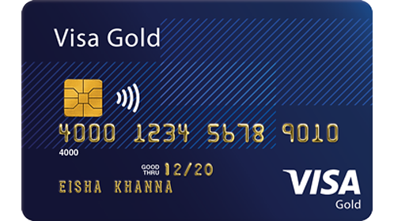
Credit card fraud detection
Presented by -
Ganesh Jagzap

Slide 12
Contents
Abstract
Introduction
Problem statement
fraud detection process
technology used
machine learning
python
Types of machine learning algorithm
Algorithm used
Advantages
conclusion and future scope

Slide 13
Abstract
Due to cashless transection every people use ATM card and credit card for transaction , so fraud can also be increase.
Billions of dollars of loss are caused every year by fraudulent credit card transaction . The design of efficient fraud detection algorithms is key for reducing these losses, and more and more algorithms rely on advanced machine learning techniques to assist fraud investigators

Slide 14
Introduction
The online shopping growing day to day. Credit cards are used for purchasing goods and services with the help of virtual card and physical card where as virtual card for online transaction and physical card for offline transaction.
In a physical-card based purchase, the cardholder presents his card physically to a merchant for making a payment. If the cardholder does not realize the loss of card, it can lead to a substantial financial loss to the credit card company. In online payment mode, attackers need only little information for doing fraudulent transaction (secure code, card number, expiration date etc.).

Slide 15
Problem Statement
Credit card fraud stands as major problem for world wide financial institutions. Annual lost due to it scales to billions of dollars.

Slide 16
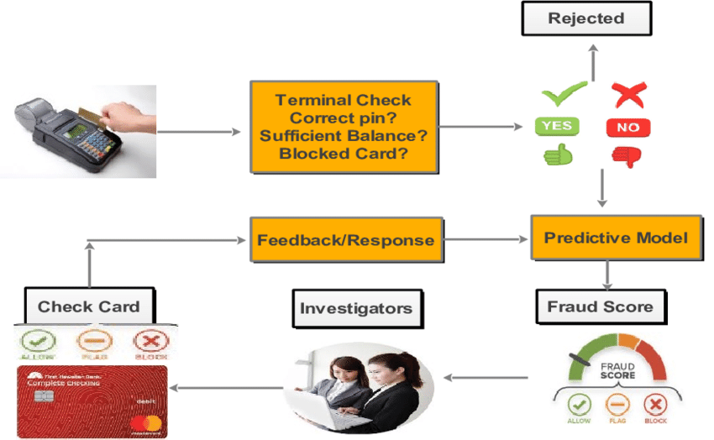
Fraud detection process

Slide 17
TECHNOLOGY USED
Machine Learning
► Machine learning is the scientific study of algorithms and static models that computer system use in order to perform a specific task effetely without using the explicit instruction, relaying on patterns and interface instead.
► Machine learning algorithms build a mathematical model based on sample data, known as training data in order to make prediction and decisions.
► Machine learning algorithms are used in email filtering, face recognition, etc.

Slide 18
TYPES OF MACHINE LEARNING ALGORITHMS
SUPERVISED LEARNING
UN-SUPERVISED LEARNING
REINFORCEMENT LEARNING

Slide 19
Supervised
Learning
Supervised learning as the name indicates the presence of a supervisor as a teacher.
Supervised learning algorithm build a mathematical model of a set of data that contain both input and output.
Basically supervised learning is a learning in which we teach or train the machine using data which is well labeled that means some data is already tagged with the correct answer.
After that, the machine is provided with a new set of examples(data) so that supervised learning algorithm analyses the training data (set of training examples) and produces a correct outcome from labeled data.

Slide 20
Unsupervised learning is the training of machine using information that is neither classified nor labeled and allowing the algorithm to act on that information without guidance. Here the task of machine is to group unsorted information according to similarities, patterns and differences without any prior training of data.
Unlike supervised learning, no teacher is provided that means no training will be given to the machine. Therefore machine is restricted to find the hidden structure in unlabeled data by our-self.
Unsupervised
Learning:

Slide 21
Reinforcement Learning:
Reinforcement learning is an area of Machine Learning. It is about taking suitable action to maximize reward in a particular situation.
It is employed by various software and machines to find the best possible behavior or path it should take in a specific situation.
Reinforcement learning differs from the supervised learning in a way there is no answer key but the reinforcement agent decides what to do to perform the given tack

Slide 22
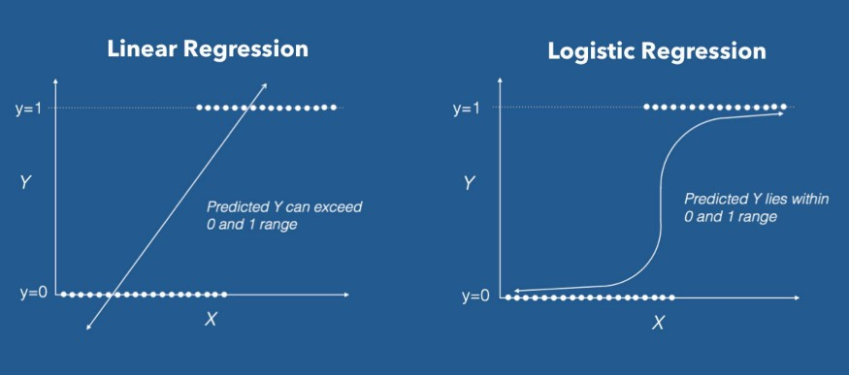
Algorithm used:
Logistic Regression is a Machine Learning algorithm which is used for the classification problems, it is a predictive analysis algorithm and based on the concept of probability.
Logistic regression:

Slide 23
The results obtained by the Logistic Regression Algorithm is best compared to any other Algorithms. The Accuracy obtained was almost equal to cent percent which proves using of Logistic algorithm gives best results.
Advantages :

Slide 24
Conclusion and Future Scope
Fraud Detection system have become essential for banks and financial institution, to minimize their losses.
However, there is a lack of published literature on credit card fraud detection techniques, due to the unavailable credit card transaction dataset for researches.
We designed a system to detect fraud in credit card transaction. This system is capable of providing most of the essential features required to detect fraudulent and legitimate transactions.
The dataset available on day to day processing may become outdated, it is necessary to have updated data for effective fraud behavior identification.

Slide 25
Sales Recommendation System
Presented by -
Jay Sawant

Slide 26
Contents
Abstract
Introduction
Problem statement
Sales recommendation process
Algorithms used
Advantages
Conclusion.

Slide 27
Abstract
The sales forecast is based on Big Mart sales for various outlets to adjust the business model to expected outcomes. The resulting data can then be used to prediction potential sales volumes for retailers such as Big Mart through various machine learning methods. The estimate of the system proposed should take account of price tag, outlet and outlet location
Currently, supermarket run-centres, Big Marts keep track of each individual item's sales data in order to anticipate potential consumer demand and update inventory management. Anomalies and general trends are often discovered by mining the data warehouse's data store. For retailers like Big Mart, the resulting data can be used to forecast future sales volume using various machine learning techniques like . A predictive model that developed using Xgboost, Linear regression, Polynomial regression, and Ridge regression techniques for forecasting the sales of a business such as Big –Mart is demonstrated ahead.

Slide 28
Introduction
Everyday competitiveness between various shopping centres as and as huge marts is becoming higher intense, violent just because of the quick development of global malls & also online shopping.
Each market seeks to offer personalized and limited-time deals to attract many clients relying on period of time, so that each item's volume of sales may be estimated for the organization's stock control, transportation and logistical services.
The current machine learning algorithm is very advanced and provides methods for predicting or forecasting sales of any kind of organization, extremely beneficial to overcome low – priced used for prediction.
Always better prediction is helpful, both in developing and improving marketing strategies for the marketplace, which is also particularly helpful.

Slide 29
Problem Statement
Create a prediction system which will always helpful in developing and enhancing corporate market strategies, which also help to increase awareness of the market.

Slide 30
Process flow
Big Mart Dataset
Preprocessing
Regression & Classification Models
Linear Regression
Polynomial Regression
XG boost
Rigid Classifier
Predicted Result

Slide 31
Algorithms used
Random Forest
Decision Tree
XGBoost
Linear Regression
Ridge Regression
Linear Regression is a machine learning algorithm based on supervised learning. It performs a regression task. Regression models a target prediction value based on independent variables. It is mostly used for finding out the relationship between variables and forecasting. Different regression models differ based on – the kind of relationship between dependent and independent variables, they are considering and the number of independent variables being used.
Random Forest is a tree-based bootstrapping algorithm that combines a certain number of weak learners (decision trees) to construct a powerful model of prediction. For each person learner, a random set of rows and a few randomly selected variables are used to create a decision tree model. Final prediction may be a function of all the predictions made by the individual learners.
Ridge Regression is a method used where multicollinearity (independent variables are highly correlated) affects outcomes. While the least square estimates (OLS) are objective in multicollinearity, their variances are broad and deviate from the true value.
Decision tree is a classifier referred to as a tuple recursive in instant-space. It is a powerful way of multi-variable analysis and is a powerful technique for data mining. Applications can be used in various fields, and this approach represents the variables involved in achieving a given purpose and the motives for achieving the target and the methods of execution.
XGBoost stands for eXtreme Gradient Boosting. The implementati-on of the algorithm was engineered for the efficiency of computing time and memory resources.

Slide 32
Advantages
Sales forecasts provide insight into how a firm should manage its workforce, cash flow, and the means.
The outcome of machine learning algorithms will help to select the most suitable demand prediction algorithm and with the aid of which Big Mart will prepare its marketing campaigns.
This is an important precondition for the planning and decision-making of enterprises.
It allows businesses to formulate their business plans effectively.
It will effectively helpful in collecting and managing revenue expenditure

Slide 33
Conclusion
Experts also shown that a smart sales forecasting program is required to manage vast volumes of data for business organizations.
Business assessments are based on the speed and precision of the methods used to analyze the results. The Machine Learning should provide an effective method for data shaping and decision-making.
New approaches that can better identify consumer needs and formulate marketing plans will be implemented

Slide 34
Movie Recommendation System
Presented by -
Atharv Wankhede

Slide 35
Contents
Abstract
Introduction
Problem Statement
Technology used
Algorithm used
Advantages
Conclusion

Slide 36
Abstract
The main goal of this Data science and machine learning project is to build a recommendation engine that recommends movies to users. This project is designed to understand the functioning of how a recommendation system works. We will be developing an Item Based Collaborative Filter.
A recommendation system takes the information about the user as an input. The recommendation system is an implementation of the machine learning algorithms.

Slide 37
Introduction
We now live in what some call the “era of abundance”. For any given product, there are sometimes thousands of options to choose from. Think of the examples above: streaming videos, social networking, online shopping; the list goes on. Recommender systems help to personalize a platform and help the user find something they like.
The easiest and simplest way to do this is to recommend the most popular items. However, to really enhance the user experience through personalized recommendations, we need dedicated recommender systems.

Slide 38
Problem Statement
Create a movie recommendation system which will help the user recommendations of movies by using users watched movies history.

Slide 39
Technology used
Machine Learning
Machine Learning is the field of study that gives computers the capability to learn without being explicitly programmed. ML is one of the most exciting technologies that one would have ever come across. As it is evident from the name, it gives the computer that makes it more similar to humans: The ability to learn. Machine learning is actively being used today, perhaps in many more places than one would expect.

Slide 40
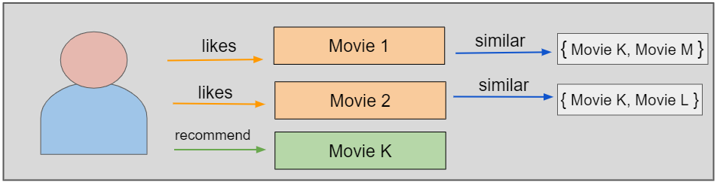
Algorithm used
Content-Based Movie Recommendation Systems
Content-based methods are based on the similarity of movie attributes. Using this type of recommender system, if a user watches one movie, similar movies are recommended. For example, if a user watches a comedy movie starring Adam Sandler, the system will recommend them movies in the same genre or starring the same actor, or both. With this in mind, the input for building a content-based recommender system is movie attributes.

Slide 41
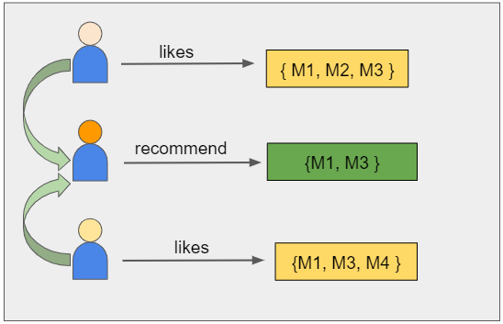
Collaborative Filtering Movie Recommendation Systems
With collaborative filtering, the system is based on past interactions between users and movies. With this in mind, the input for a collaborative filtering system is made up of past data of user interactions with the movies they watch

Slide 42
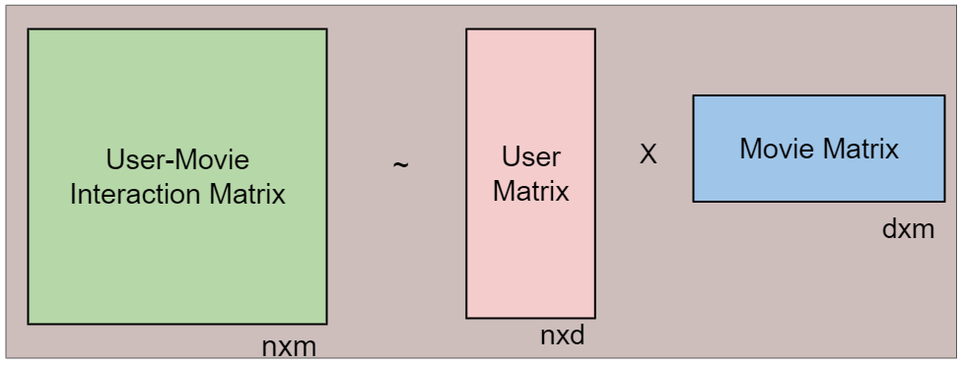
Matrix factorization is a class of collaborative filtering algorithms used in recommender systems. This family of methods became widely known during the Netflix prize challenge due to how effective it was.
Matrix factorization algorithms work by decomposing the user-movie interaction matrix into the product of two lower dimensionality rectangular matrices, say U and M. The decomposition is done in such a way that the product results in almost similar values to the user-movie interaction matrix. Here, U represents the user matrix, M represents the movie matrix, n is the number of users, and m is the number of movies. Each row of the user matrix represents a user and each column of the movie matrix represents a movie
Matrix Factorization-based Algorithm

Slide 43
Advantages
Using above algorithm the movie recommendation system becomes more efficient and helps the user to get accurate recommendations of movies.
The user gets the movie recommendation by the algorithm Content-Based Movie Recommendation Systems and Collaborative Filtering Movie Recommendation Systems.

Slide 44
Conclusion
Recommendation Systems are the most popular type of machine learning applications that are used in all sectors. They are an improvement over the traditional classification algorithms as they can take many classes of input and provide similarity ranking based algorithms to provide the user with accurate results. These recommendation systems have evolved over time and have incorporated many advanced machine learning techniques to provide the users with the content that they want

Slide 45


